Slide 1
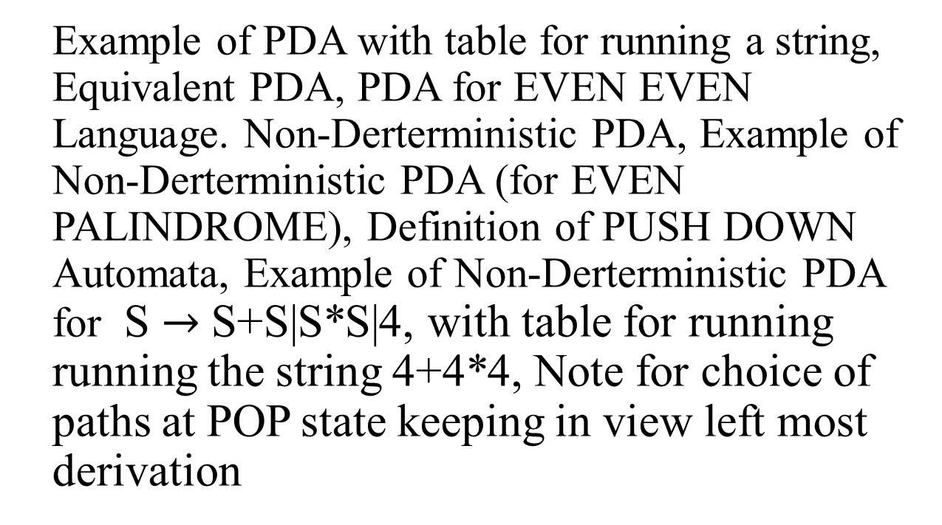
Recap lecture 38
Example of PDA with table for running a string, Equivalent PDA, PDA for EVEN EVEN Language. Non-Derterministic PDA, Example of Non-Derterministic PDA (for EVEN PALINDROME), Definition of PUSH DOWN Automata, Example of Non-Derterministic PDA for S $→$ S+S|S*S|4, with table for running running the string 4+4*4, Note for choice of paths at POP state keeping in view left most derivation

Slide 2
PDA corresponding to CFG
Theorem: Corresponding to any CFG there exists a PDA accepting the language generated by the CFG.
Since an algorithm has already been discussed to convert the CFG in CNF, so the PDA can be constructed corresponding to the CFG. As the CFG in CNF generates all the nonnull words of the corresponding CFL, so accepting the null string (if it is contained in the CFL), can be managed separately. Following is an example in this regard

Slide 3
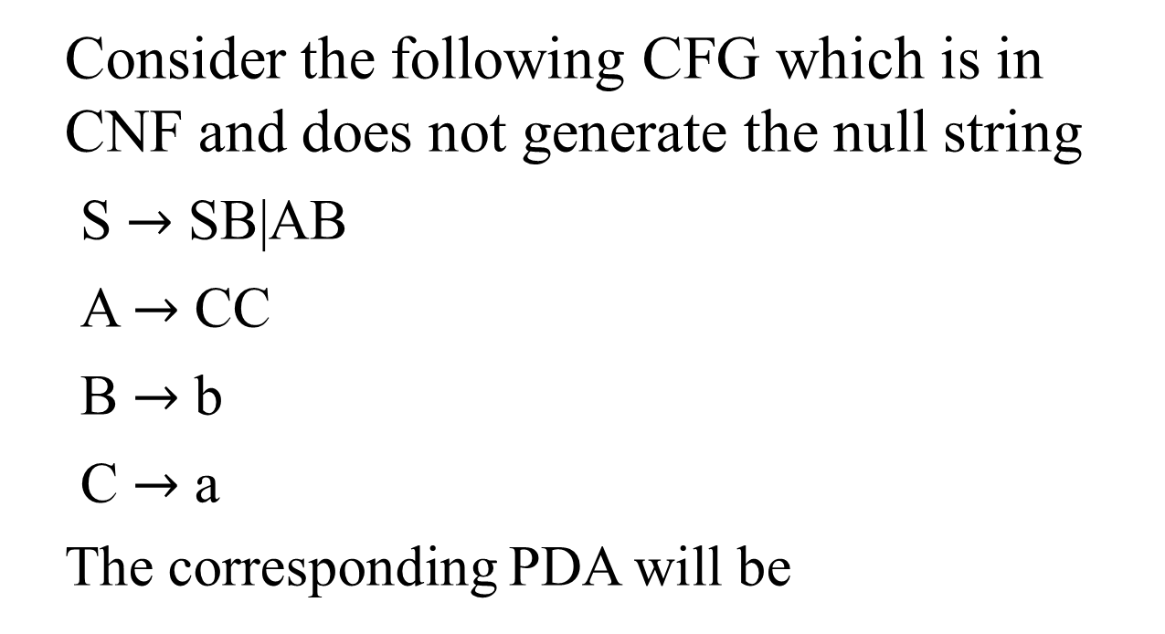
Example
Consider the following CFG which is in CNF and does not generate the null string
S $→$ SB|AB
A $→$ CC
B $→$ b
C $→$ a
The corresponding PDA will be

Slide 4
a
b
RD₁
RD₂
AT
ST
∆
C
B
PH S
∆
PP
RD₃
S
A
S
PH B
PH B
PH C
PH S
PH A
PH C

Slide 5
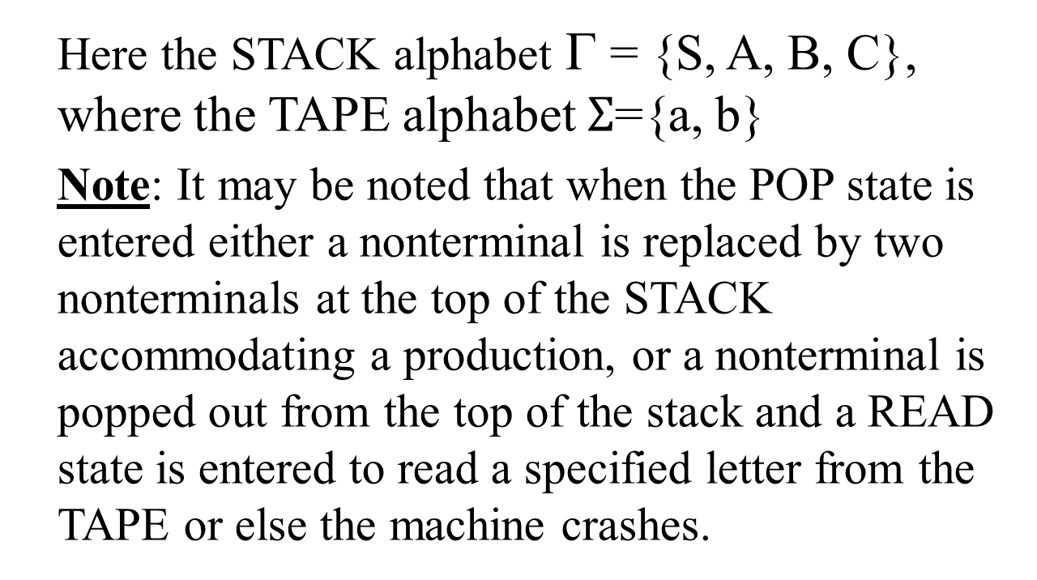
Example continued …
Here the STACK alphabet Γ = {S, A, B, C}, where the TAPE alphabet $Σ$={a, b}
Note: It may be noted that when the POP state is entered either a nonterminal is replaced by two nonterminals at the top of the STACK accommodating a production, or a nonterminal is popped out from the top of the stack and a READ state is entered to read a specified letter from the TAPE or else the machine crashes.

Slide 6
Example continued …
The choice of path taken at POP state to accommodate the word belonging to the CFL can be determined by the left most derivation of the word. Consider the word aab with its left most derivation, as follows

Slide 7
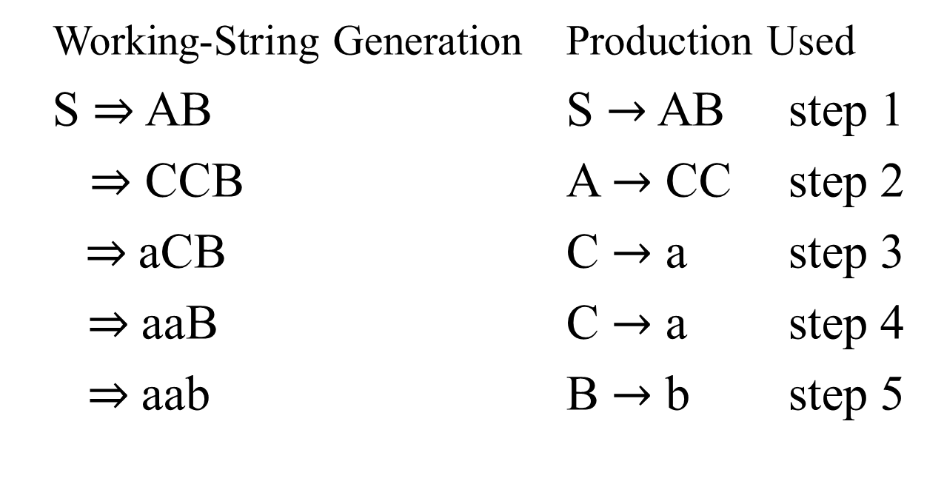
Example continued …
Working-String Generation Production Used
S $⇒$ AB S $→$ AB step 1
$⇒$ CCB A $→$ CC step 2
$⇒$aCB C $→$ a step 3
$⇒$ aaB C $→$ a step 4
$⇒$ aab B $→$ b step 5

Slide 8
Example continued …
First of all the START state is entered
The PUSH S state is entered
STACK
TAPE
∆…
aab∆…
STACK
TAPE
S
aab∆…

Slide 9
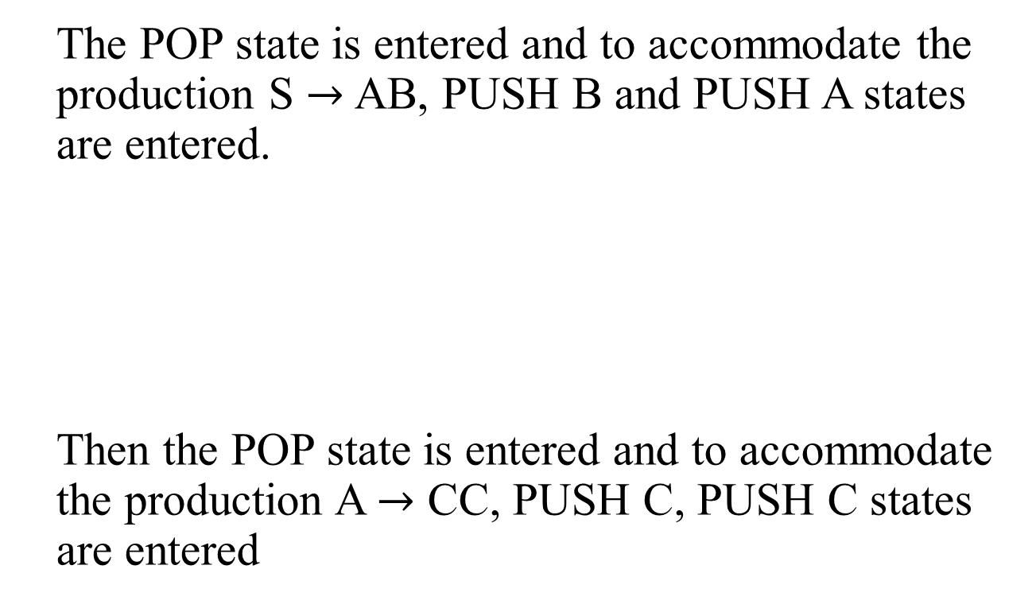
Example continued …
The POP state is entered and to accommodate the production S $→$ AB, PUSH B and PUSH A states are entered.
Then the POP state is entered and to accommodate the production A $→$ CC, PUSH C, PUSH C states are entered
STACK
TAPE
AB
aab∆…

Slide 10
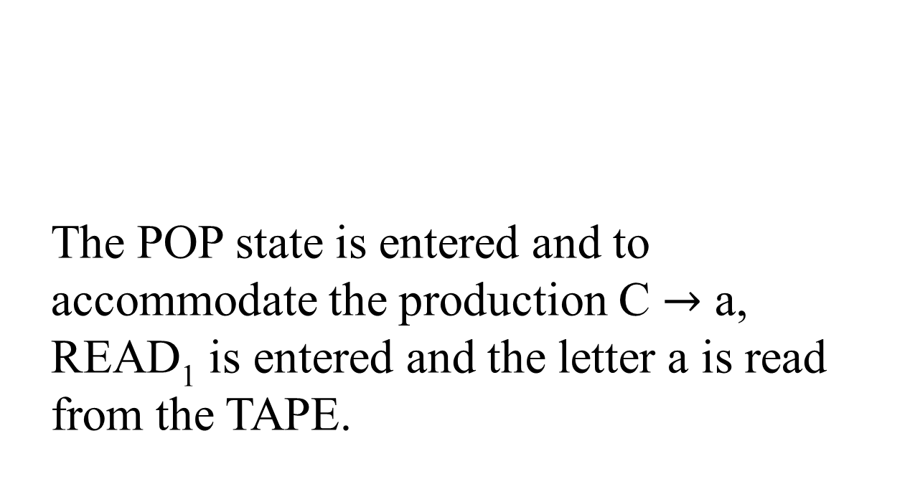
Example continued …
STACK
TAPE
The POP state is entered and to accommodate the production C $→$ a, READ₁ is entered and the letter a is read from the TAPE.
CCB
aab

Slide 11

Example continued …
STACK
TAPE
The POP state is entered and to accommodate the production C $→$ a, READ₁ state is entered and the letter a is read from the TAPE
CB
aab
STACK
TAPE
B
aab

Slide 12


Example continued …
The POP state is entered and to accommodate the production B $→$ b, READ₂ state is entered and the letter b is read from the TAPE
STACK
TAPE
$$Δ$$
aab

Slide 13
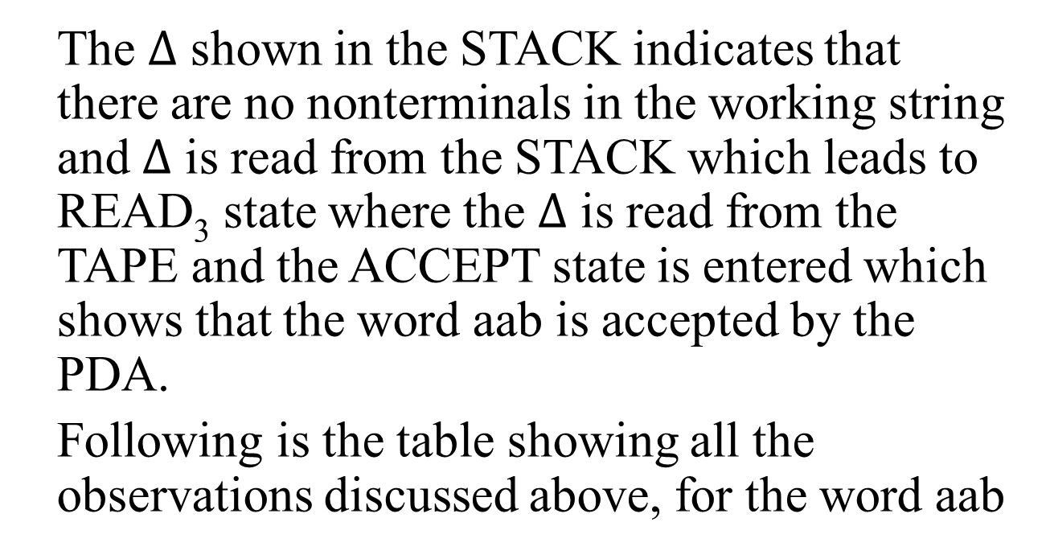
Example continued …
The $Δ$ shown in the STACK indicates that there are no nonterminals in the working string and $Δ$ is read from the STACK which leads to READ₃ state where the $Δ$ is read from the TAPE and the ACCEPT state is entered which shows that the word aab is accepted by the PDA.
Following is the table showing all the observations discussed above, for the word aab

Slide 14
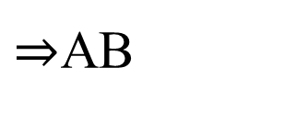
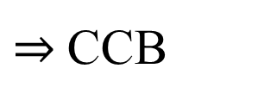


Example continued …
Left most derivation
STATE
STACK
TAPE
START
$$Δ$$
aab
S
PUSH S
S
aab
POP
$$Δ$$
aab
PUSH B
B
aab
$⇒$AB
PUSH A
AB
aab
POP
B
aab
PUSH C
CB
aab
$⇒$CCB
PUSH C
CCB
aab
POP
CB
aab

Slide 15

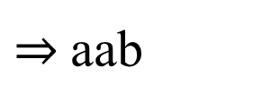
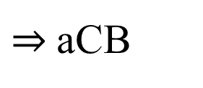
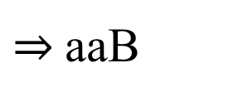
Example continued …
$⇒$aCB
READ₁
CB
aab
POP
B
aab
$⇒$aaB
READ₁
B
aab
POP
$$Δ$$
aab
$⇒$aab
READ₂
Δ
aab
POP
Δ
aab
READ₃
Δ
aab
ACCEPT
Δ
aab
Following is an example of building the PDA corresponding to the given CFG

Slide 16
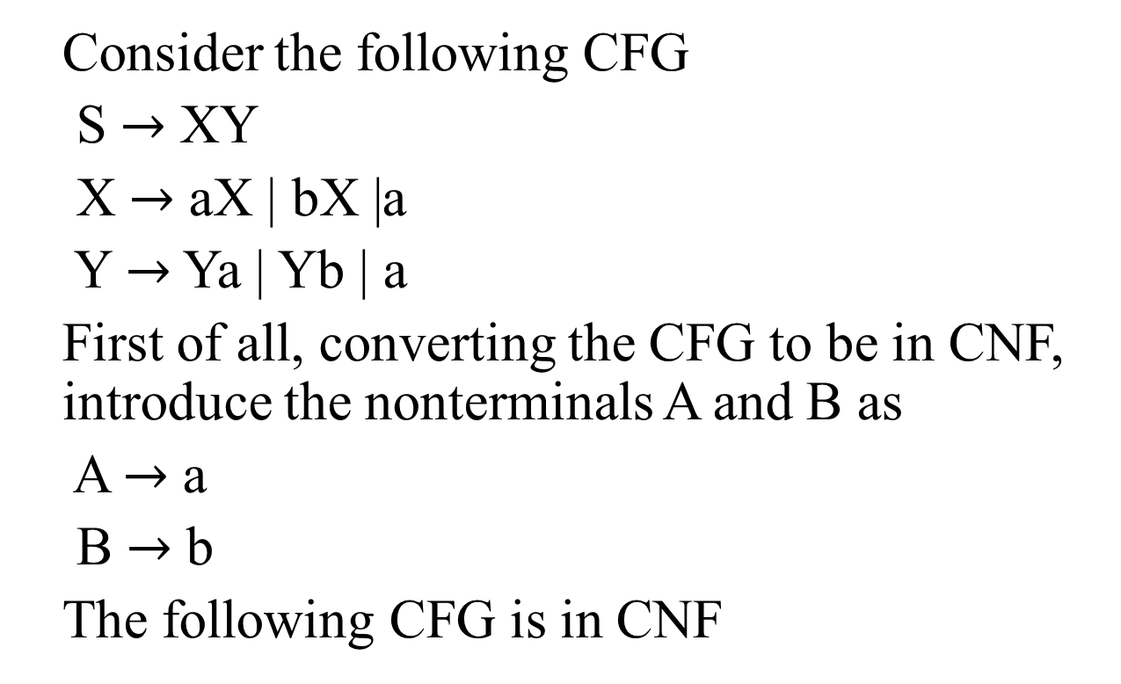
Example
Consider the following CFG
S $→$ XY
X $→$ aX | bX |a
Y $→$ Ya | Yb | a
First of all, converting the CFG to be in CNF, introduce the nonterminals A and B as
A $→$ a
B $→$ b
The following CFG is in CNF

Slide 17
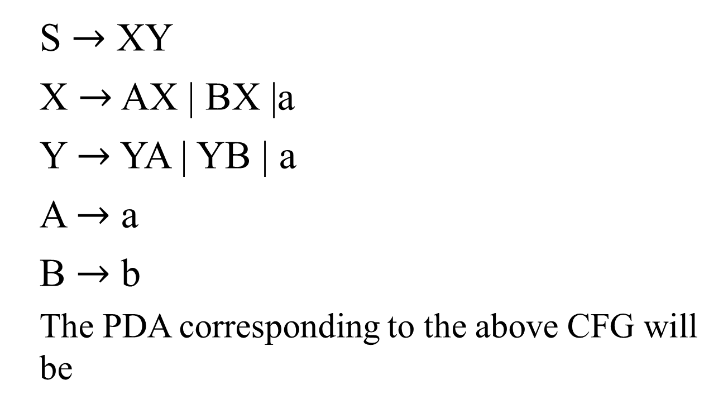
Example continued …
S $→$ XY
X $→$ AX | BX |a
Y $→$ YA | YB | a
A $→$ a
B $→$ b
The PDA corresponding to the above CFG will be

Slide 18
a
a
a
b
RD₁
RD₃
RD₄
RD₂
B
A
AT
ST
Y
X
∆
PH S
∆
PP
RD₅
S
X
X
Y
Y
PH X
PH X
PH A
PH B
PH Y
PH X
PH A
PH B
PH Y
PH Y

Slide 19
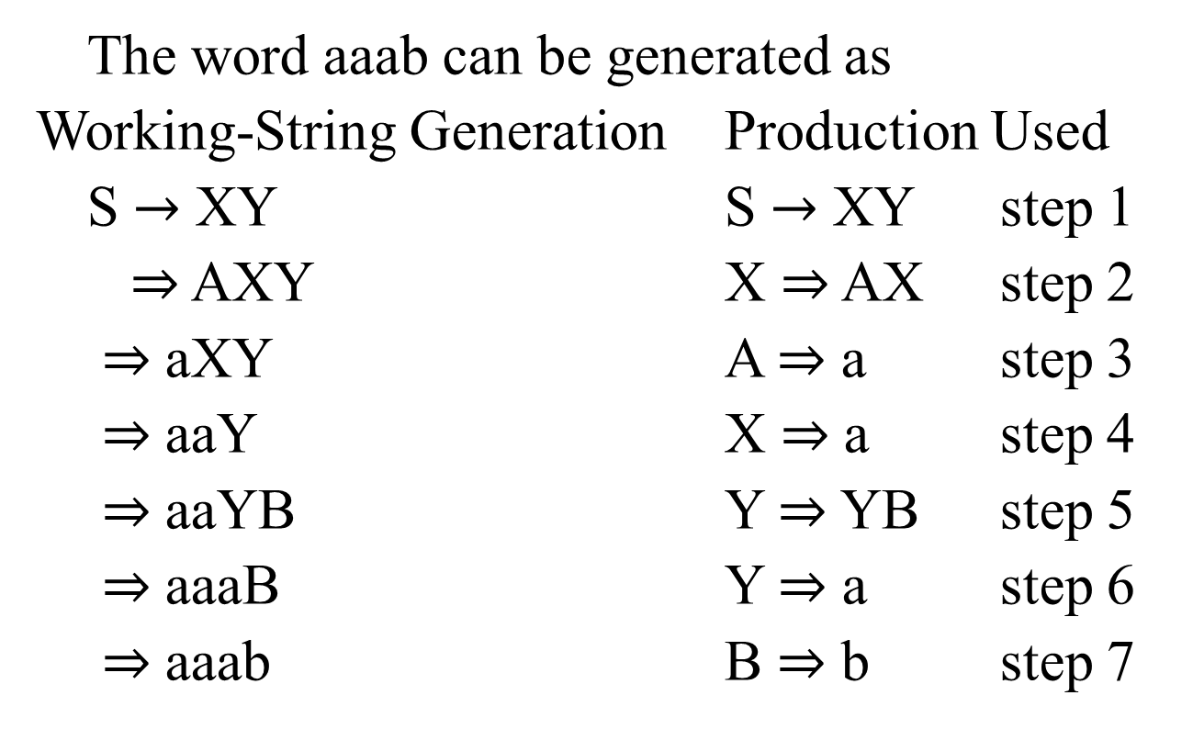
Example continued …
The word aaab can be generated as
Working-String Generation Production Used
S $→$ XY S $→$ XY step 1
$⇒$ AXY X $⇒$ AX step 2
$⇒$ aXY A $⇒$ a step 3
$⇒$ aaY X $⇒$ a step 4
$⇒$ aaYB Y $⇒$ YB step 5
$⇒$ aaaB Y $⇒$ a step 6
$⇒$ aaab B $⇒$ b step 7

Slide 20
Example continued …
STACK TAPE
STACK TAPE
(ST) ∆
aaab
(PP) Y
aaab
(PH S) S
aaab
(RD₁) Y
aaab
(PP) ∆
aaab
(PP) ∆
aabb
(PH Y) Y
aaab
(PH B) B
aabb
(PH X) XY
aaab
(PH Y)YB
aabb
(PP) Y
aaab
(PP) B
aaab
(PH X)XY
aaab
(RD₂) B
aaab
(PHA)AXY
aaab
(PP) ∆
aaab
(PP) XY
aaab
(RD₄) ∆
aaab
(RD₃)XY
aaab
(PP) ∆
∆

Slide 21
Summing Up
PDA corresponding to CFG, Examples of PDA corresponding to CFG

